Slide 1
HMM Review

Slide 2
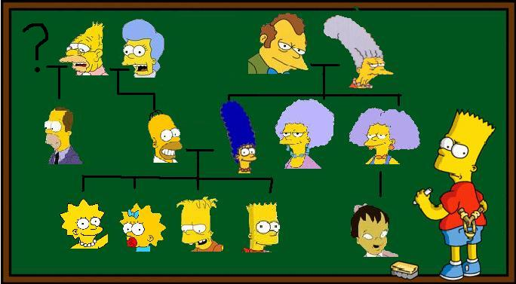
Some basic concepts: Probabilities over large collections, Markov models, and some of their family tree..
SPFLODD, 22 Jan 2018
Bhiksha Raj

Slide 3
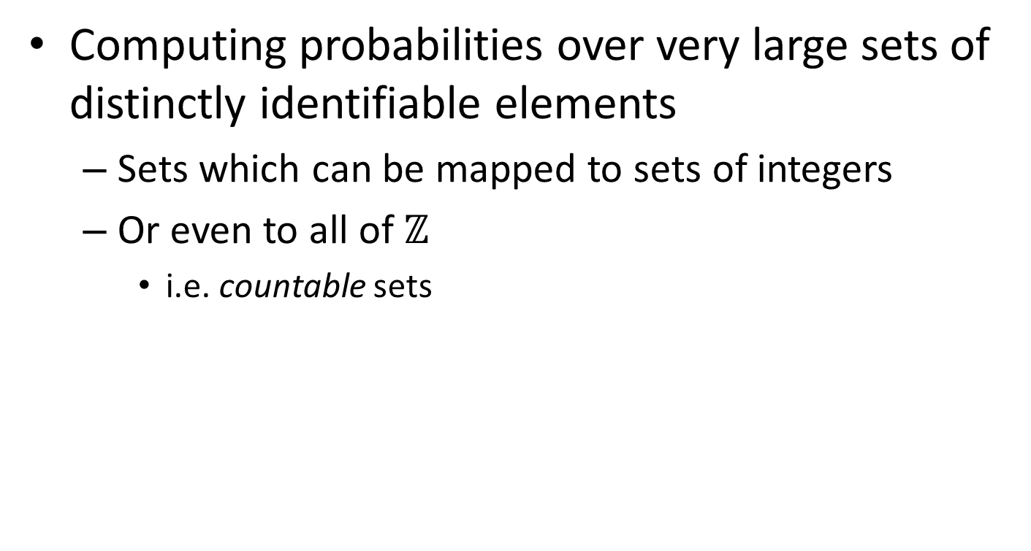
Distributions over discrete sets
Computing probabilities over very large sets of distinctly identifiable elements
Sets which can be mapped to sets of integers
Or even to all of $ℤ$
i.e. countable sets

Slide 4
Discrete sets: Examples
The set of all integers with exactly N digits
How large is this set?
The set of all integers with up to N digits
How large is this set?
Other examples?
Notes:
All possible sentences you can speak in 15 seconds.
All possible character sequences
All possible segmentations (is this merely large, or countable)
All musical melodies in C major

Slide 5
Discrete sets: Examples
The set of all integers with exactly N digits
The set of all integers with up to N digits
Other examples?
All possible sentences you can speak in 15 seconds.
All possible character sequences
All musical melodies in C major
All melodies in C major that require less than 5 minutes to sing
Notes:
All possible sentences you can speak in 15 seconds.
All possible character sequences
All possible segmentations (is this merely large, or countable)
All musical melodies in C major

Slide 6
Discrete sets: Examples
Segmentation:
Ireturnedandsawunderthesunthattheraceisnottotheswiftnorthebattletothestrongneitheryetbreadtothewisenoryetrichestomenofunderstandingnoryetfavortomenofskillbuttimeandchancehappentothemall
How many possible sentences?
Assuming any sequence of characters is a valid word?
Assuming words must come from a fixed dictionary?
Notes:
All possible sentences you can speak in 15 seconds.
All possible character sequences
All possible segmentations (is this merely large, or countable)
All musical melodies in C major

Slide 7
Discrete sets: Examples
Segmentation:
Ireturnedandsawunderthesunthattheraceisnottotheswiftnorthebattletothestrongneitheryetbreadtothewisenoryetrichestomenofunderstandingnoryetfavortomenofskillbuttimeandchancehappentothemall
With correction:
Iretrunedandsawunnderthhesunthettheraceisnottothesviftnorthebatletothestrongneitheryetbreadtotheweisenoryetrichestomenofandurstendinnoryetfeyvortomenofskillbuttymeandchancehappenetothemall
Notes:
All possible sentences you can speak in 15 seconds.
All possible character sequences
All possible segmentations (is this merely large, or countable)
All musical melodies in C major

Slide 8
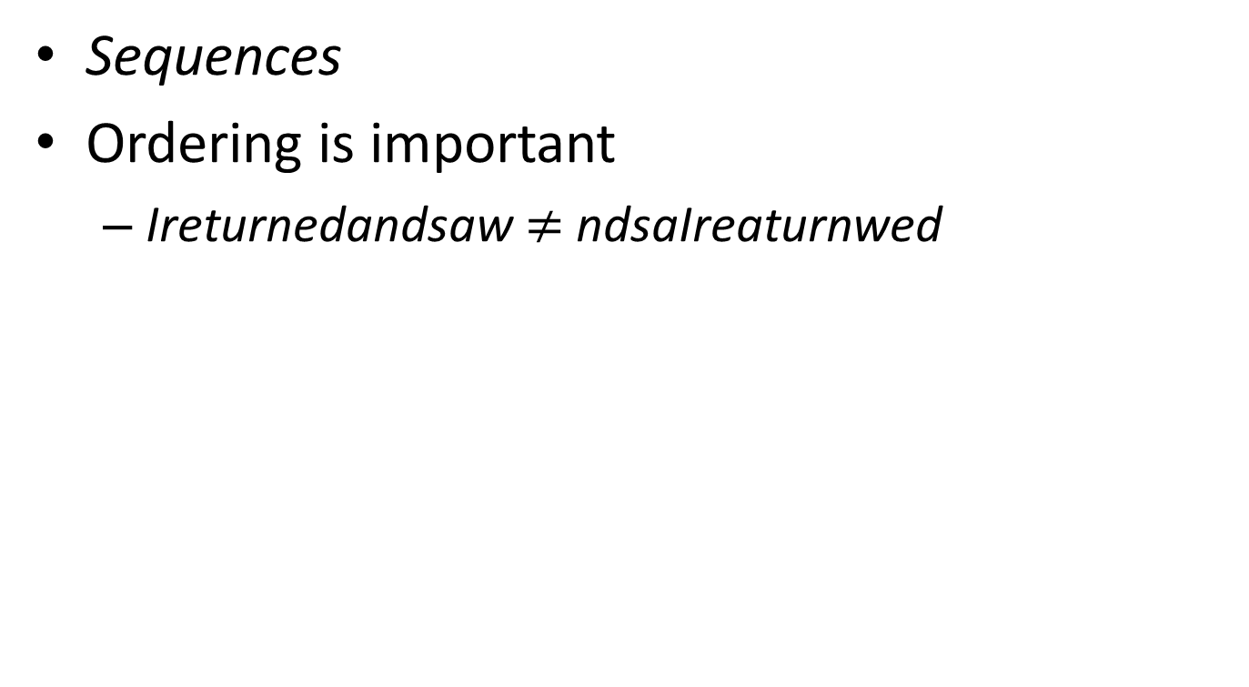
A characteristic of the examples you saw..
Sequences
Ordering is important
Ireturnedandsaw $≠$ ndsaIreaturnwed

Slide 9
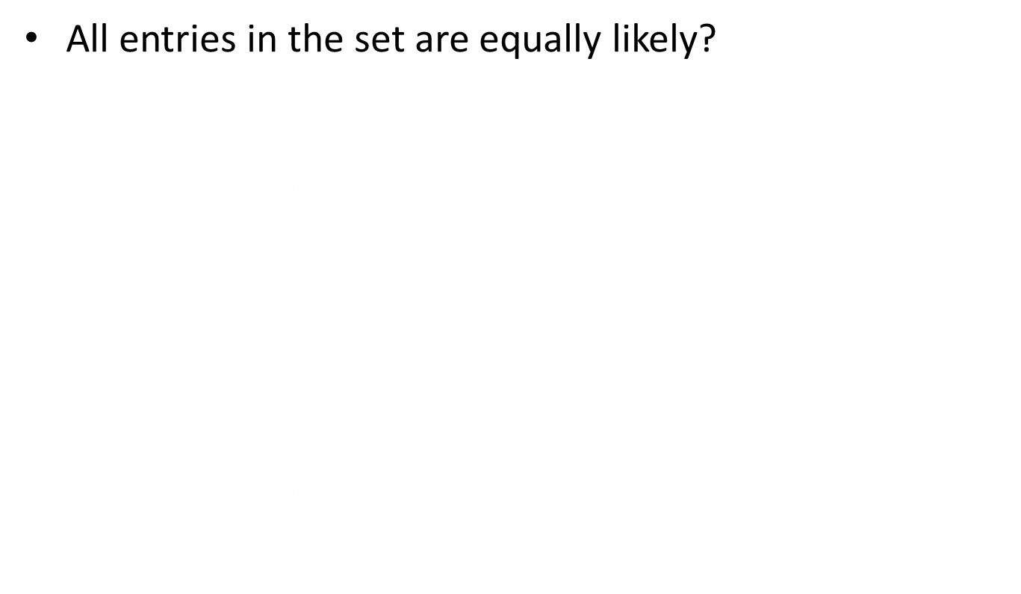
Assigning probabilities to discrete sets
All entries in the set are equally likely?
The probability of any entry with $N$ elements in the sequence is proportional to $1/N$
The total probability of all entries of length $N$ is proportional to $1/N$
The probability of any entry with N elements in the sequence is proportional to $1/N^{1+ε}$
$ε>0$

Slide 10
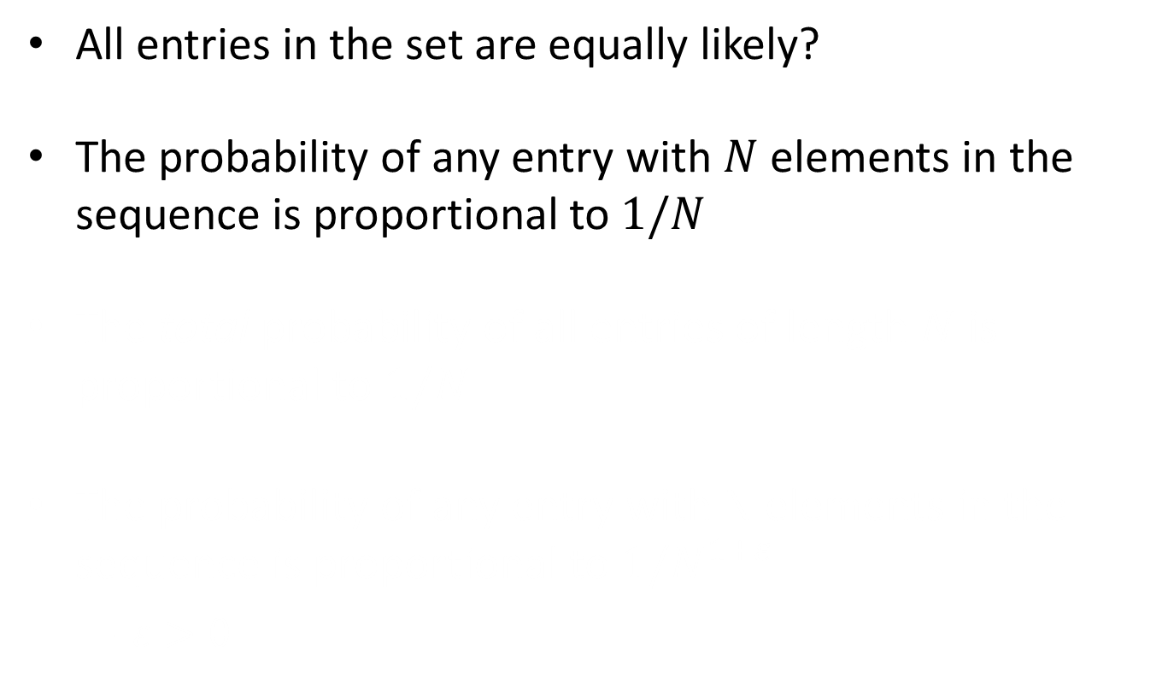
Assigning probabilities to discrete sets
All entries in the set are equally likely?
The probability of any entry with $N$ elements in the sequence is proportional to $1/N$
The total probability of all entries of length $N$ is proportional to $1/N$
The probability of any entry with N elements in the sequence is proportional to $1/N^{1+ε}$
$ε>0$

Slide 11
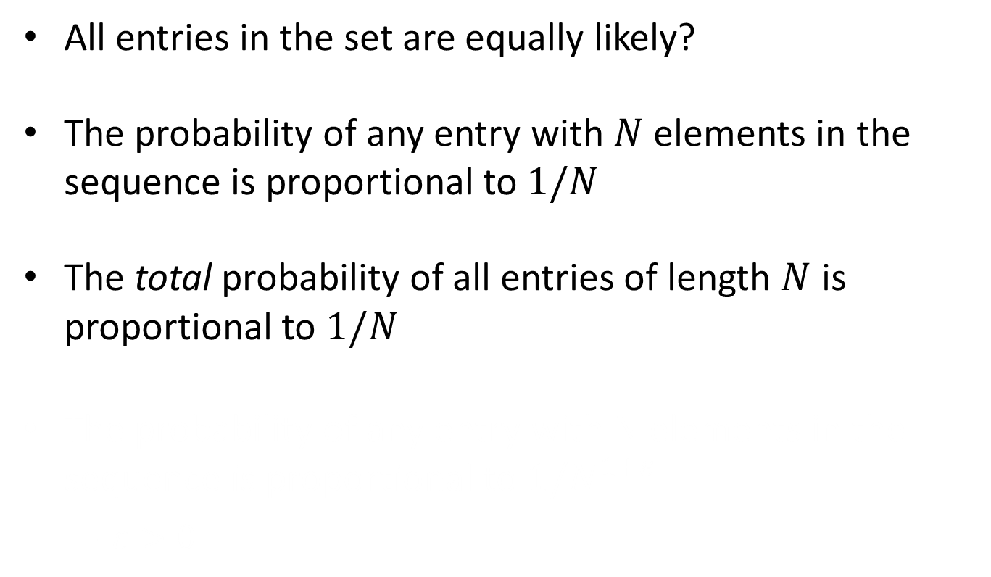
Assigning probabilities to discrete sets
All entries in the set are equally likely?
The probability of any entry with $N$ elements in the sequence is proportional to $1/N$
The total probability of all entries of length $N$ is proportional to $1/N$
The probability of any entry with N elements in the sequence is proportional to $1/N^{1+ε}$
$ε>0$

Slide 12
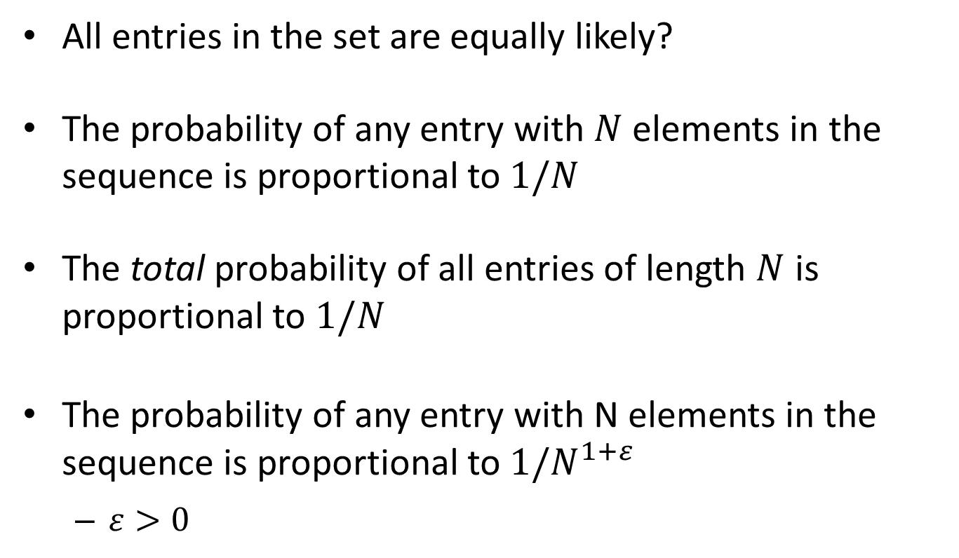
Assigning probabilities to discrete sets
All entries in the set are equally likely?
The probability of any entry with $N$ elements in the sequence is proportional to $1/N$
The total probability of all entries of length $N$ is proportional to $1/N$
The probability of any entry with N elements in the sequence is proportional to $1/N^{1+ε}$
$ε>0$

Slide 13
Assigning Probabilities over Discrete Sets
Segmentation:
Ireturnedandsawunderthesunthattheraceisnottotheswiftnorthebattletothestrong…
“All generatable sentences are equally likely”?
With correction:
Iretrunedandsawunnderthhesunthettheraceisnottothesviftnorthebatletothestrong…
“All generatable sentences are equally likely”?

Slide 14
Assigning Probabilities over Discrete Sets
Segmentation:
Ireturnedandsawunderthesunthattheraceisnottotheswiftnorthebattletothestrong…
“All generatable sentences are equally likely”?
With correction:
Iretrunedandsawunnderthhesunthettheraceisnottothesviftnorthebatletothestrong…
“All generatable sentences are equally likely”?

Slide 15
Assigning Probabilities over Discrete Sets
Segmentation:
Ireturnedandsawunderthesunthattheraceisnottotheswiftnorthebattletothestrong…
“All generatable sentences are equally likely”?
Why is this a bad idea?
Because this assumes no structure
Structure:
Some sequences are more likely than others
Some sequences never happen
Knowing that there is structure is not the same as knowing the structure

Slide 16
Assigning Probabilities over Discrete Sets
Segmentation:
Ireturnedandsawunderthesunthattheraceisnottotheswiftnorthebattletothestrong…
“All generatable sentences are equally likely”?
Why is this a bad idea?
Because this assumes no structure
Structure:
Some sequences are more likely than others
Some sequences never happen
Knowing that there is structure is not the same as knowing the structure

Slide 17
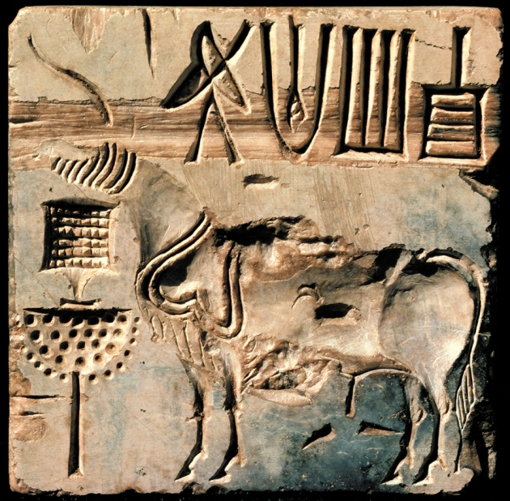
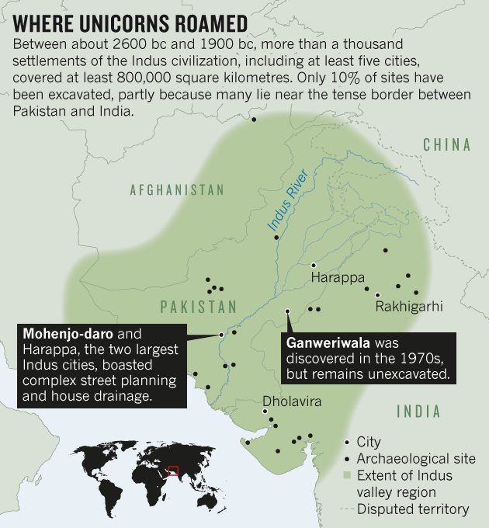
The Indus Valley Civilization
The mysterious Indus unicorn on a roughly 4,000-year-old sealstone, found at the Mohenjo-daro site. (from Nature, April 16)
One of the oldest civilizations, known to have been extremely advanced
Only known advanced civilization that left no evidence of warfare, or even armies!!!
But nobody has yet deciphered their script!

Slide 18
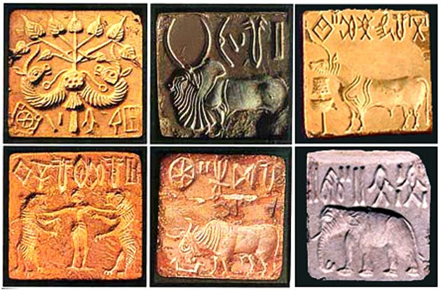

The Indus Valley Script
The Indus script is made up of partially pictographic signs and human and animal motifs including a puzzling 'unicorn'. These are inscribed on miniature steatite (soapstone) seal stones, terracotta tablets and occasionally on metal. The designs are “little masterpieces of controlled realism, with a monumental strength in one sense out of all proportion to their size and in another entirely related to it”, wrote the best-known excavator of the Indus civilization, Mortimer Wheeler, in 19681.
From Nature, April 2016

Slide 19

A Controversy
Electronic Journal of Vedic Studies, 2004

Slide 20
The not a language hypothesis
Indus valley inscriptions are only between 5 and 14 characters long
The distribution of symbols is no different from the Zipfian distribution of decorative symbols in various illiterate cultures
The entropy of the distributions shows a lack of structure associated with a real language of any kind
Still an ongoing controversy
I suspect Sproat is right that these don’t represent true script.
This does not mean the I-V civilization didn’t have a script; just that they did not record it on stone…
Example of not knowing if there is structure!

Slide 21
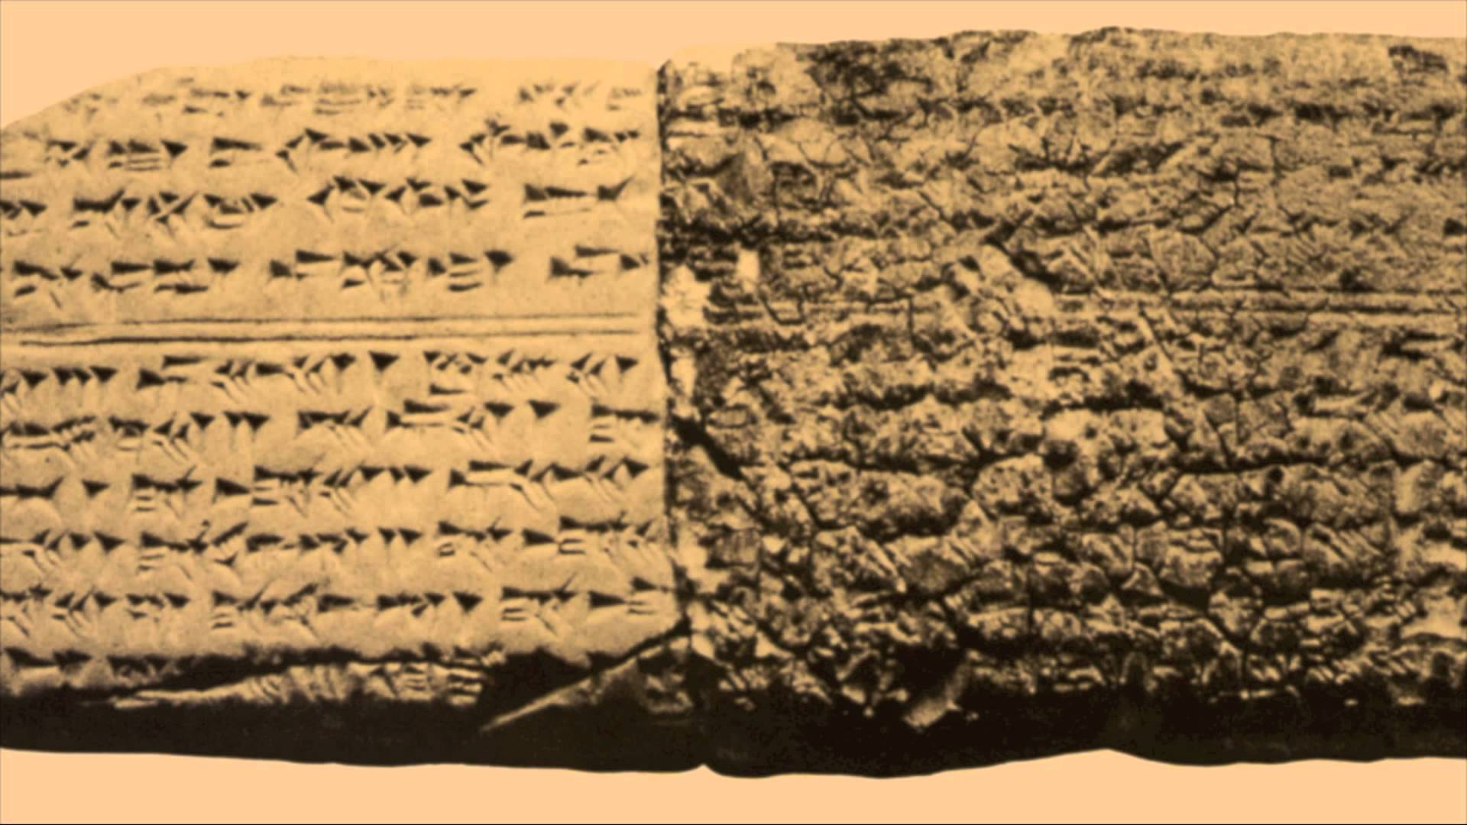
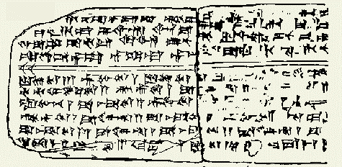
World’s oldest known music: Hurrian Hymn
Music transcriptions discovered in the Amorite-Canaanite city of Ugarit (Ras Shamra in modern day Syria)
From Ca 1400BC!
Oldest notated music known

Slide 22
Hurrian Hymns
36 songs found in all
Songs to Amorite gods
Of these, only Hymn no. 6 written to Nikkal, the goddess of orchards, is complete
Known to be music
Amorites wrote in Akkadian, which is understood
Attendant inscriptions describe the music
Some of them include the name of the compose
Though not Hymn no. 6
Even includes instruction that it must be sung by a singer with a lyre

Slide 23
What is missing???
What do those symbols mean??
What are the notes?
Or the cadence?
No analogy to any other music available
Structure is known to be present, but the structure is not understood!!

Slide 24
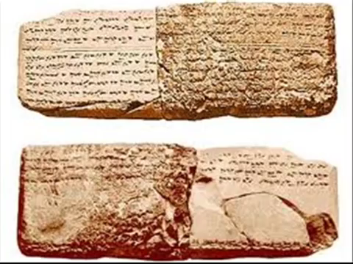


The outcomes..
http://www.urkesh.org/urkeshpublic/music.htm
Hm…

Slide 25
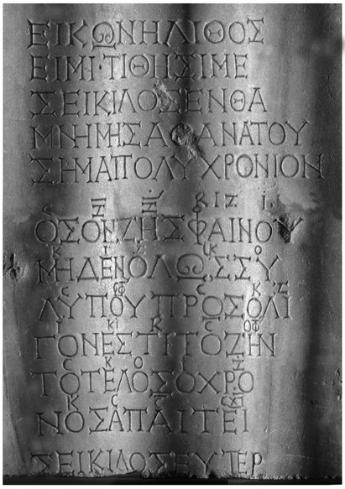
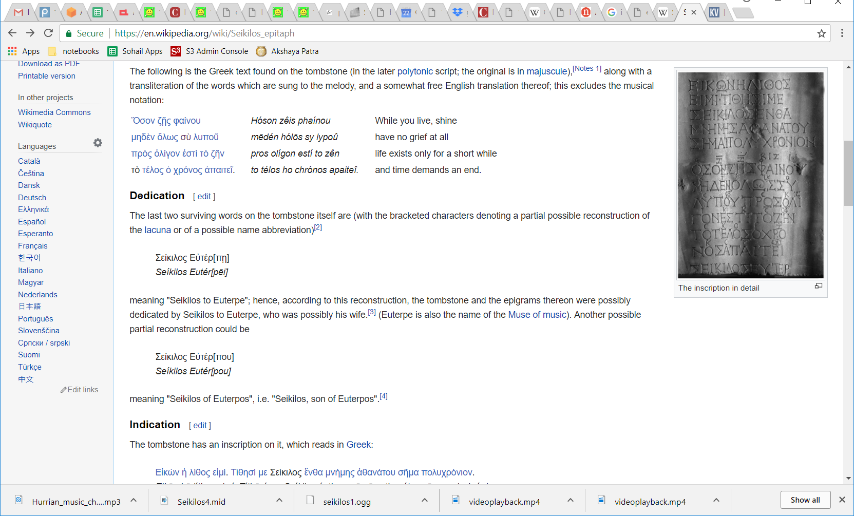
When interpretation is not a problem
Seikilos Epitaph
Somewhere between 200BC and 100 AD, probably closer to the latter
Either from Seikilos to his wife, Euterpe, or simply the epitaph of Seikilos, son of Euterpos
The musical notation is understood
Oldest complete piece of music

Slide 26

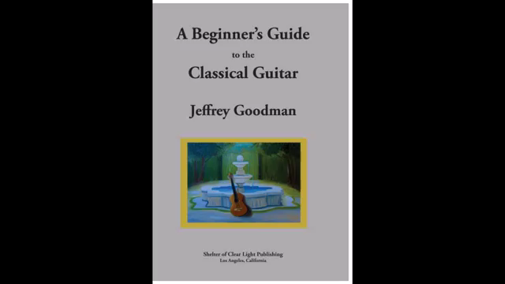
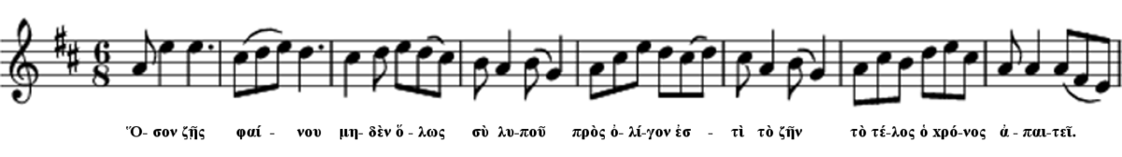
Seikilos Epitaph

Slide 27
How did we interpret this?
So how does one go from the information on the left to the information on the right?

Slide 28
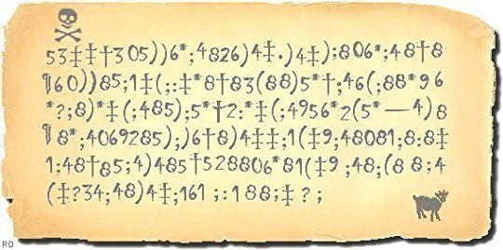
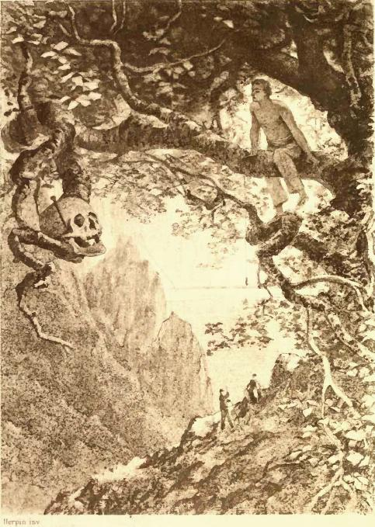
The Gold Bug (Edgar Allan Poe)
Whut?

Slide 29
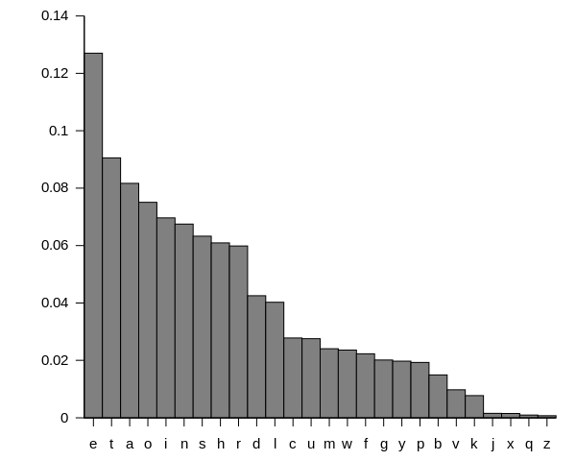
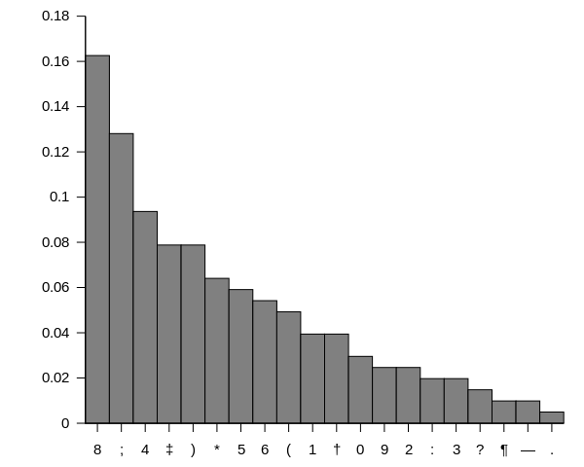
The Gold Bug (Edgar Allan Poe)
From Wikipedia: Original images by Wikipedis users Nandhp and Atar
Comparing letter frequency histograms
If that fails, you can use frequencies of bigrams of characters (most frequent character pair: “TH”)
http://norvig.com/mayzner.html

Slide 30
The Gold Bug (Edgar Allan Poe)
53‡‡†305))6*;4826)4‡.)4‡);806*;48†8
agoodglassinthebishopshostelinthede
¶60))85;;]8*;:‡*8†83(88)5*†;46(;88*96
vilsseattwentyonedegreesandthirteenmi
*?;8)*‡(;485);5*†2:*‡(;4956*2(5*—4)8
nutesnortheastandbynorthmainbranchse
¶8*;4069285);)6†8)4‡‡;1(‡9;48081;8:8‡
venthlimbeastsideshootfromthelefteyeo
1;48†85;4)485†528806*81(‡9;48;(88;4
fthedeathsheadabeelinefromthetreeth
(‡?34;48)4‡;161;:188;‡?;
roughtheshotfiftyfeetout
Substitution cipher; based on comparison of trivial surface level statistics
Even works for music if its from the same genre

Slide 31
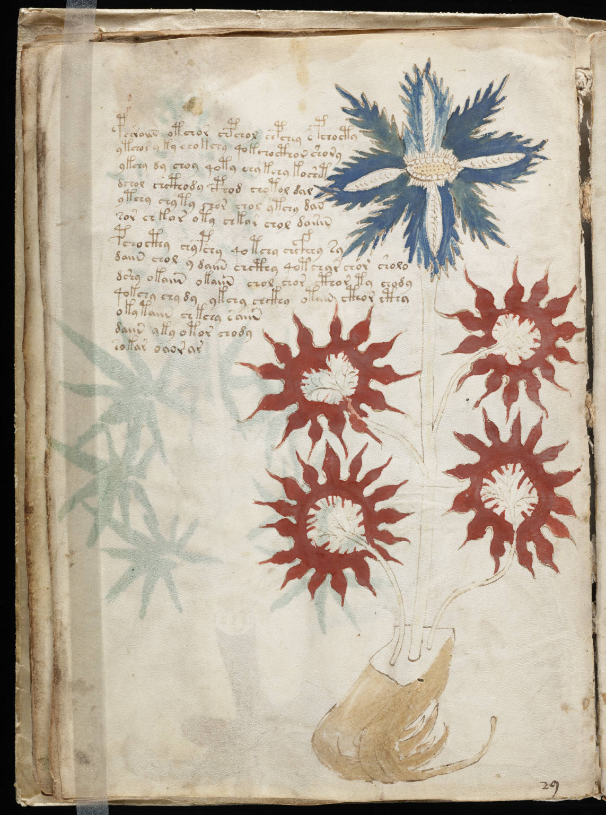
More more complex things
Ca 1400-1430
The Voynich manuscript
In cipher?
Still undeciphered
What do we do?

Slide 32
Need to characterize the language
Statistically model the structure of the language
Model the probability distribution over a potentially infinite set, such that every entry gets assigned a realistic probability
The probability must sum to 1.0 obviously
Any ideas?

Slide 33
Need to characterize the language
Statistically model the structure of the language
In this course we will largely model language as Markov
I.e. produced by a Markov process
Hypothesis: Markov process models nicely capture the structure of the language
And can be used to generate, categorize, compare languages etc.
Lets understand Markov processes a little..

Slide 34


Slide 35


The story of Flider and Spy
Flider the spider is at the far corner of the room, and Spy the fly is sleeping happily at the near corner

Slide 36


The story of Flider and Spy
Flider only walks along edges
She begins walking along one of the three edges at random
She takes one minute to cover the distance from one corner to the other along any edge
When she arrives at the new corner, she randomly chooses one of the three edges and continues walking (she may even turn back)

Slide 37
The story of Flider and Spy
?
What is the life expectancy of Spy?

Slide 38
Markov process
Markov Process: Does not matter how you got here, only matters where you are

Slide 39

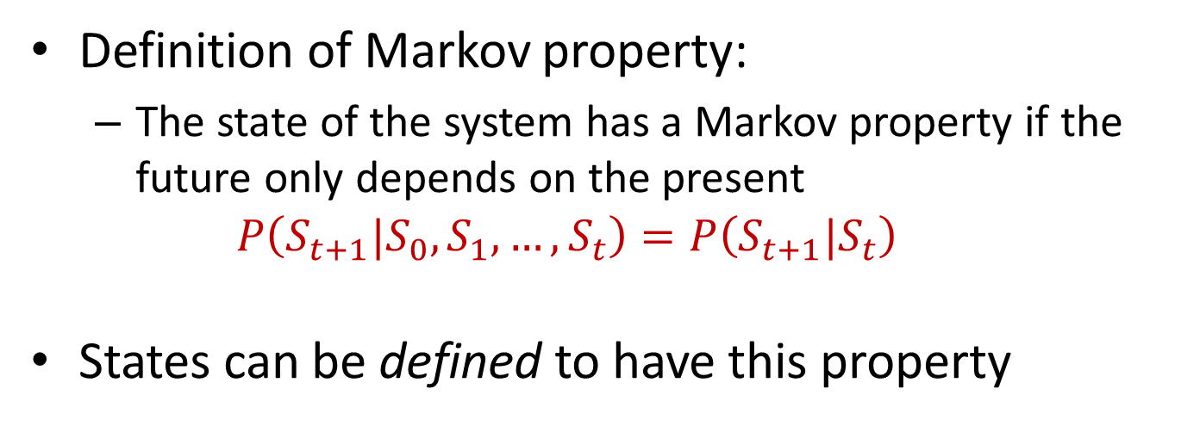
The World as we model It
Where the spider can go next only depends on where she is
Definition of Markov property:
The state of the system has a Markov property if the future only depends on the present
$$P\left(S_{t+1}|S_{0},S_{1},…,S_{t}\right)=P\left(S_{t+1}|S_{t}\right)$$
States can be defined to have this property

Slide 40
Discrete-State Markov Process
1
2
3
4
5
6
7
8
1
2
3
5
4
6
7
8
AKA Markov Chain
The process (flider) can be in one of a number of states (corners)
At any state the process can transition into another states, based on a probability distribution that is only dependent on the current state

Slide 41
Discrete-State Markov Process
What characterizes this process?
Number of states
The complete set of transition probabilities P(Si|Sj) that determine the probability with which the process transitions to Si, when its in Sj
1
2
3
4
5
6
What is the complete set of transition probabilities P(Si|Sj) in this example?
7
8
1
2
3
5
4
6
7
8
AKA Markov Chain
The process (flider) can be in one of a number of states (corners)
At any state the process can transition into another states, based on a probability distribution that is only dependent on the current state

Slide 42
Discrete-State Markov Process
What characterizes this process?
Number of states
The complete set of transition probabilities P(Si|Sj) that determine the probability with which the process transitions to Si, when its in Sj
1
2
3
4
Is there a different way of characterizing this process, which is also Markov?
5
6
7
8
1
2
3
5
4
6
7
8
AKA Markov Chain
The process (flider) can be in one of a number of states (corners)
At any state the process can transition into another states, based on a probability distribution that is only dependent on the current state

Slide 43


An alternate Markov representation
1.0
1.0
2/3
s₃
s₂
s₁
1/3
s₀
1/3
2/3
A Markov process definition may not be unique!
The same set of outcomes may be derived from multiple processes!

Slide 44

The absorbing state
1.0
1.0
2/3
s₃
s₂
s₁
1/3
s₀
1/3
2/3
What happens when Flider catches Spy?
There‘s no more wandering to be done
This is an absorbing state with self-transition probability = 1

Slide 45

Introducing…. Glider!!
Glider, Flider’s brother, never turns around during his wanderings
On arriving at any corner, he chooses one of the two “forward” paths randomly.
The future possibilities depend on the edge he arrived from
Is he Markovian?

Slide 46
Introducing…. Rider!!
Rider, Glider’s picky twin is even more fastidious
She considers his past two corners before choosing the next one to go to.
Is she Markovian?

Slide 47
Introducing…. Rider!!
Schneider considers every place he’s been, and the order in which he’s been there, since he was born!
Is he Markovian?

Slide 48
Introducing.. The “information” state
By appropriately defining an information state, any discrete process can be modelled as Markov
Simply modelling a process as Markov imparts no new insight into its structure!!

Slide 49
Need to characterize the language
Statistically model the structure of the language
In this course we will largely model language as Markov
I.e. produced by a Markov process
Hypothesis: Markov process models nicely capture the structure of the language
And can be used to generate, categorize, compare languages etc.
Lets understand Markov processes a little..
Really????

Slide 50

Need to characterize the language
Statistically model the structure of the language
In this course we will largely model language as Markov
I.e. produced by a Markov process
Hypothesis: Markov process models nicely capture the structure of the language
And can be used to generate, categorize, compare languages etc.
Lets understand Markov processes a little..
Really????
Only if you define the information state properly
Notes:
Only if you define the information state properly.

Slide 51
An on that happy note….

Slide 52
The shortest path algorithm
2
2
1
1
1
1
2
2
2
1
1
2
1
1
2
3
1
2
4
2
1
What is the shortest path from the red to the black node?

Slide 53
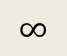




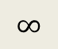



Dijkstra’s Algorithm
$$0$$
2
$$∞$$
$$∞$$
2
2
1
1
$$∞$$
$$∞$$
1
2
2
2
$$∞$$
1
1
2
1
1
2
3
1
2
$$∞$$
4
2
1
$$∞$$
$$∞$$
Set the cost of the initial node to 0 and all other nodes to infinity
Start at the initial node

Slide 54
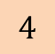
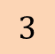
Dijkstra’s Algorithm
$$0$$
2
$$4$$
$$∞$$
2
2
1
1
$$3$$
$$∞$$
1
2
2
2
$$∞$$
1
1
2
1
1
2
3
1
2
$$∞$$
4
2
1
$$∞$$
$$∞$$
“Expand” the initial node out along all outgoing paths
At the destination nodes, record the cost

Slide 55

Dijkstra’s Algorithm
$$0$$
2
$$4$$
$$∞$$
2
2
1
1
$$3$$
$$∞$$
1
2
2
2
$$∞$$
1
1
2
1
1
2
3
1
2
$$∞$$
4
2
1
$$∞$$
$$∞$$
Mark initial node as “done”

Slide 56

Dijkstra’s Algorithm
$$0$$
2
$$4$$
$$∞$$
2
2
1
1
$$3$$
$$∞$$
1
2
2
2
$$∞$$
1
1
2
1
1
2
3
1
2
$$∞$$
4
2
1
$$∞$$
$$∞$$
Select the node with the lowest cost

Slide 57
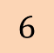
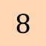
Dijkstra’s Algorithm
$$0$$
2
$$4$$
$$∞$$
2
2
1
1
$$3$$
$$∞$$
1
2
2
2
$$6$$
1
1
2
1
1
2
3
1
2
$$∞$$
4
2
1
$$8$$
$$∞$$
“Expand” it along all outgoing edges
Node path costs at destination nodes

Slide 58

Dijkstra’s Algorithm
$$0$$
2
$$4$$
$$∞$$
2
2
1
1
$$3$$
$$∞$$
1
2
2
2
$$6$$
1
1
2
1
1
2
3
1
2
$$∞$$
4
2
1
$$8$$
$$∞$$
Mark node as “done”

Slide 59

Dijkstra’s Algorithm
$$0$$
2
$$4$$
$$∞$$
2
2
1
1
$$3$$
$$∞$$
1
2
2
2
$$6$$
1
1
2
1
1
2
3
1
2
$$∞$$
4
2
1
$$8$$
$$∞$$
Select the node with the lowest cost

Slide 60

Dijkstra’s Algorithm
$$0$$
2
$$4$$
$$7$$
2
2
1
1
$$3$$
$$∞$$
1
2
2
2
$$6$$
1
1
2
1
?
1
2
3
1
2
$$∞$$
4
2
1
$$8$$
$$∞$$
Expand it out as before
What do we do when an expansion arrives at a node that already has a cost assigned to it?

Slide 61
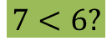
Dijkstra’s Algorithm
$$0$$
2
$$4$$
$$7$$
2
2
1
1
$$3$$
$$∞$$
1
2
2
2
$$6$$
1
1
$$7<6?$$
2
1
?
1
2
3
1
2
$$∞$$
4
2
1
$$8$$
$$∞$$
Retain the lower of the current cost at the node and the cost of the expanded incoming edge

Slide 62
Dijkstra’s Algorithm
$$0$$
2
$$4$$
$$7$$
2
2
1
1
$$3$$
$$∞$$
1
2
2
2
$$6$$
1
1
2
1
?
1
2
3
1
2
$$∞$$
4
2
1
$$8$$
$$∞$$
Retain the lower of the current cost at the node and the cost of the expanded incoming edge

Slide 63

Dijkstra’s Algorithm
$$0$$
2
$$4$$
$$7$$
2
2
1
1
$$3$$
$$∞$$
1
2
2
2
$$6$$
1
1
2
1
?
1
2
3
1
2
$$∞$$
4
2
1
$$8$$
$$∞$$

Slide 64
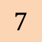
Dijkstra’s Algorithm
$$0$$
2
$$4$$
$$7$$
2
2
1
1
$$3$$
$$∞$$
1
2
2
2
$$6$$
1
1
2
1
?
1
2
3
1
2
$$∞$$
4
2
1
$$8$$
$$7$$

Slide 65

Dijkstra’s Algorithm
$$0$$
2
$$4$$
$$7$$
2
2
1
1
$$3$$
$$∞$$
1
2
2
2
$$6$$
1
1
2
1
?
1
2
3
1
2
$$∞$$
4
2
1
$$8$$
$$7$$

Slide 66

Dijkstra’s Algorithm
$$0$$
2
$$4$$
$$7$$
2
2
1
1
$$3$$
$$∞$$
1
2
2
2
$$6$$
1
1
2
1
?
1
2
3
1
2
$$∞$$
4
2
1
$$8$$
$$7$$

Slide 67

Dijkstra’s Algorithm
$$0$$
2
$$4$$
$$7$$
2
2
1
1
$$3$$
$$∞$$
1
2
2
2
$$6$$
1
1
2
1
?
1
2
3
1
2
$$∞$$
4
2
1
$$8$$
$$7$$

Slide 68

Dijkstra’s Algorithm
$$0$$
2
$$4$$
$$7$$
2
2
1
1
$$3$$
$$∞$$
1
2
2
2
$$6$$
1
1
2
1
?
1
2
3
1
2
$$∞$$
4
2
1
$$8$$
$$7$$
When the least cost node is the target node, we’re done
We have the cost of the shortest path from the red to the black node

Slide 69
A variation on the problem
1
3
4
1
3
1
1
1
1
1
1
1
1
2
2
1
3
When the graph is topologically sorted..
Assumption: No nodes before the identified source node
In practice, we can “kill” all earlier nodes and their outgoing edges without affecting the result

Slide 70
A variation on the problem
1
3
4
1
3
1
1
1
1
1
1
1
1
2
1
2
1
3
Start from the source node

Slide 71
A variation on the problem
1
3
4
1
3
1
1
1
1
1
1
1
1
2
1
2
1
3
Start from the source node
Going left to right, for each subsequent node, retain the lowest incoming cost

Slide 72
A variation on the problem
1
3
4
1
3
1
1
1
1
1
1
1
1
2
1
3
2
1
3
Start from the source node
Going left to right, for each subsequent node, retain the lowest incoming cost

Slide 73
A variation on the problem
1
3
4
1
3
1
1
1
1
1
1
1
1
2
5
2
1
3
1
3
Start from the source node
Going left to right, for each subsequent node, retain the lowest incoming cost

Slide 74
A variation on the problem
1
3
4
1
3
5
1
1
1
1
1
1
1
1
2
5
2
1
3
1
3
Start from the source node
Going left to right, for each subsequent node, retain the lowest incoming cost

Slide 75
A variation on the problem
1
3
4
1
3
5
1
1
1
1
1
1
1
1
2
5
2
3
1
3
1
3
Start from the source node
Going left to right, for each subsequent node, retain the lowest incoming cost

Slide 76
A variation on the problem
1
3
4
1
3
5
1
1
1
1
1
1
1
1
2
5
2
3
1
3
6
1
3
Start from the source node
Going left to right, for each subsequent node, retain the lowest incoming cost

Slide 77
Is this graph topologically sorted?
Nodes on each column only connect to the nodes in the previous column(s)

Slide 78
Is this graph topologically sorted?
4
8
12
16
20
24
3
7
11
15
19
23
2
6
10
14
18
22
1
5
9
13
17
21
Nodes on each column only connect to the nodes in the previous column(s)
The sorted best path algorithm applies!

Slide 79
Shortest path algorithm
Order of evaluation to find the shortest path between the given source and destination

Slide 80
Shortest path algorithm
Order of evaluation to find the shortest path between the given source and destination

Slide 81
Shortest path algorithm
Order of evaluation to find the shortest path between the given source and destination

Slide 82
Shortest path algorithm
Order of evaluation to find the shortest path between the given source and destination

Slide 83
Shortest path algorithm
Order of evaluation to find the shortest path between the given source and destination

Slide 84
Shortest path algorithm
Order of evaluation to find the shortest path between the given source and destination

Slide 85
Shortest path algorithm
Order of evaluation to find the shortest path between the given source and destination

Slide 86
Shortest path algorithm
Order of evaluation to find the shortest path between the given source and destination

Slide 87
Shortest path algorithm
Order of evaluation to find the shortest path between the given source and destination

Slide 88
Shortest path algorithm
Order of evaluation to find the shortest path between the given source and destination

Slide 89
Shortest path algorithm
Order of evaluation to find the shortest path between the given source and destination

Slide 90
Shortest path algorithm
Order of evaluation to find the shortest path between the given source and destination

Slide 91
Shortest path algorithm
Order of evaluation to find the shortest path between the given source and destination

Slide 92
Shortest path algorithm
Order of evaluation to find the shortest path between the given source and destination

Slide 93
Shortest path algorithm
Order of evaluation to find the shortest path between the given source and destination

Slide 94
Shortest path algorithm
Order of evaluation to find the shortest path between the given source and destination

Slide 95
Shortest path algorithm
Order of evaluation to find the shortest path between the given source and destination

Slide 96
Shortest path algorithm
Order of evaluation to find the shortest path between the given source and destination

Slide 97
Shortest path algorithm
Order of evaluation to find the shortest path between the given source and destination

Slide 98
Shortest path algorithm
Order of evaluation to find the shortest path between the given source and destination

Slide 99
Shortest path algorithm
Order of evaluation to find the shortest path between the given source and destination

Slide 100
Shortest path algorithm
Order of evaluation to find the shortest path between the given source and destination

Slide 101
Shortest path algorithm
Order of evaluation to find the shortest path between the given source and destination

Slide 102
Shortest path algorithm
Order of evaluation to find the shortest path between the given source and destination

Slide 103
Shortest path algorithm
Order of evaluation to find the shortest path between the given source and destination

Slide 104
Shortest path algorithm
Order of evaluation to find the shortest path between the given source and destination

Slide 105
Shortest path algorithm
Order of evaluation to find the shortest path between the given source and destination

Slide 106
Shortest path algorithm
Order of evaluation to find the shortest path between the given source and destination

Slide 107
Shortest path algorithm
Order of evaluation to find the shortest path between the given source and destination

Slide 108
Shortest path algorithm
Order of evaluation to find the shortest path between the given source and destination

Slide 109
Shortest path algorithm
Order of evaluation to find the shortest path between the given source and destination

Slide 110
Shortest path algorithm
Order of evaluation to find the shortest path between the given source and destination

Slide 111
Shortest path algorithm
Order of evaluation to find the shortest path between the given source and destination

Slide 112


Composing directed graphs
b
1
a1
a2
$$⨀$$
$$=$$
b1
c1
b2
c2
a
c
2
Two “product” of two graphs
Each vertex on the child graph represents an unordered pair of vertices from the parent graphs
Two vertices on the child graph are connected by an edge if corresponding vertices in the parent graphs are also connected

Slide 113
Composing directed graphs
b
1
a1
a2
$$⨀$$
$$=$$
b1
c1
b2
c2
a
c
2
Two “product” of two graphs
Each vertex on the child graph represents an unordered pair of vertices from the parent graphs
Two vertices on the child graph are connected by an edge if corresponding vertices in the parent graphs are also connected
Every path through the child graph conforms to the structure of both parents

Slide 114
Composing graphs
b
1
2
3
4
a
c
A graph and a linear graph

Slide 115
Composing graphs
a
b
c
1
2
3
4
A graph and a linear graph

Slide 116
The Trellis
a
b
c
1
2
3
4
The composition of a directed graph and a linear graph results in a trellis

Slide 117
Best Path Through The Trellis
a
b
c
1
2
3
4
The composition of a directed graph and a linear graph results in a trellis

Slide 118
Best Path Through The Trellis
a
b
c
1
2
3
4
The composition of a directed graph and a linear graph results in a trellis

Slide 119
Best Path Through The Trellis
a
b
c
1
2
3
4
The composition of a directed graph and a linear graph results in a trellis

Slide 120
Best Path Through The Trellis
a
b
c
1
2
3
4
The composition of a directed graph and a linear graph results in a trellis

Slide 121
Best Path Through The Trellis
a
b
c
1
2
3
4
The composition of a directed graph and a linear graph results in a trellis

Slide 122
Best Path Through The Trellis
a
b
c
1
2
3
4
The composition of a directed graph and a linear graph results in a trellis

Slide 123
Best Path Through The Trellis
a
b
c
1
2
3
4
The composition of a directed graph and a linear graph results in a trellis

Slide 124
Best Path Through The Trellis
a
b
c
1
2
3
4
The composition of a directed graph and a linear graph results in a trellis

Slide 125
Best Path Through The Trellis
a
b
c
1
2
3
4
The composition of a directed graph and a linear graph results in a trellis

Slide 126
Best Path Through The Trellis
a
b
c
1
2
3
4
The composition of a directed graph and a linear graph results in a trellis

Slide 127
Best Path Through The Trellis
a
b
c
1
2
3
4
The composition of a directed graph and a linear graph results in a trellis

Slide 128
Best Path Through The Trellis
a
b
c
1
2
3
4
The composition of a directed graph and a linear graph results in a trellis

Slide 129
Best Path Through The Trellis
a
b
c
1
2
3
4
You just saw the Viterbi algorithm!!
Again, the best path conforms to sequential constraints imposed by both parents

Slide 130
The Trellis
a
b
c
1
2
3
4
What are the edge and node costs?
Cost(node(a,3)) = f(a,3)
Cost(edge(a3->b=3) = g(edge(a->b), edge(3->4))

Slide 131
Lecture Outline
Markov models
Hidden Markov models
Viterbi algorithm

Slide 132
Markov Models

Slide 133
One View of Text
Sequence of symbols (bytes, letters, characters, morphemes, words, …)
Let Σ denote the set of symbols.
Lots of possible sequences. (Σ* is infinitely large.)
Probability distributions over Σ*?

Slide 134
Trivial Distributions over Σ*
Give probability 0 to sequences with length greater than B; uniform over the rest.
Use data: with N examples, give probability 1/N to each observed sequence, 0 to the rest.
What if we want every sequence to get some probability?
Need a probabilistic model family and algorithms for constructing the model from data.

Slide 135
A History-Based Model
Generate each word from left to right, conditioned on what came before it.

Slide 136
A History-Based Model
Generate each word from left to right, conditioned on what came before it.
Note these guys..

Slide 137
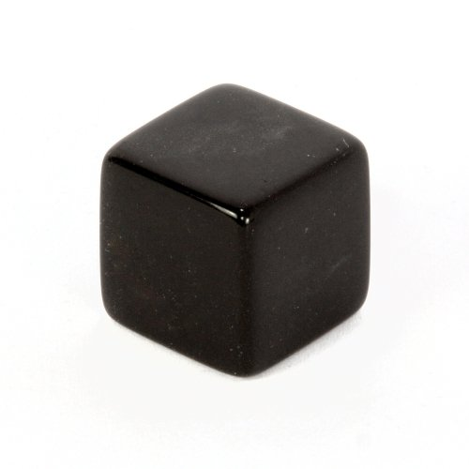
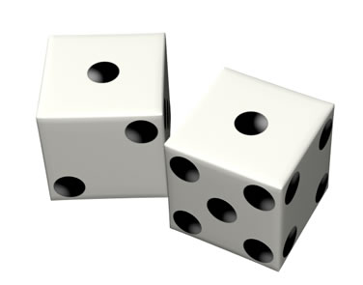
Die / Dice
one die
two dice

Slide 138
start
one die per history:
…
…
…

Slide 139
start
I
one die per history:
…
…
…
history = start

Slide 140
start
I
want
one die per history:
…
…
…
history = start I

Slide 141
start
I
want
a
one die per history:
…
…
…
history = start I want

Slide 142
start
I
want
a
flight
one die per history:
…
…
…
history = start I want a

Slide 143
start
I
want
a
flight
to
one die per history:
…
…
…
history = start I want a flight

Slide 144
start
I
want
a
flight
to
Lisbon
one die per history:
…
…
…
history = start I want a flight to

Slide 145
start
I
want
a
flight
to
Lisbon
.
one die per history:
…
…
…
history = start I want a flight to Lisbon

Slide 146
start
I
want
a
flight
to
Lisbon
.
stop
one die per history:
…
…
…
history = start I want a flight to Lisbon .

Slide 147
Is this process Markov?
start
I
want
a
flight
to
Lisbon
.
stop
one die per history:
…
…
…
history = start I want a flight to Lisbon .

Slide 148
A History-Based Model
Generate each word from left to right, conditioned on what came before it.
Very rich representational power!
How many parameters?
What is the probability of a sentence not seen in training data?

Slide 149
A Bag of Words Model
Every word is independent of every other word.

Slide 150
start
one die:

Slide 151
start
I
one die:

Slide 152
start
I
want
one die:

Slide 153
start
I
want
a
one die:

Slide 154
start
I
want
a
flight
one die:

Slide 155
start
I
want
a
flight
to
one die:

Slide 156
start
I
want
a
flight
to
Lisbon
one die:

Slide 157
start
I
want
a
flight
to
Lisbon
.
one die:

Slide 158
start
I
want
a
flight
to
Lisbon
.
stop
one die:

Slide 159
A Bag of Words Model
Every word is independent of every other word.
Strong assumptions mean this model cannot fit the data very closely.
How many parameters?
What is the probability of a sentence not seen in training data?

Slide 160
A Bag of Words Model
Every word is independent of every other word.
Strong assumptions mean this model cannot fit the data very closely.
How many parameters?
What is the probability of a sentence not seen in training data?
Is this a Markov Model?

Slide 161
A Bag of Words Model
Every word is independent of every other word.
Strong assumptions mean this model cannot fit the data very closely.
How many parameters?
What is the probability of a sentence not seen in training data?
Is this a Markov Model?
What is the information state?
Is there an absorbing state?

Slide 162
The Markov Model
w₁
w₂
start
stop
w₃
w₄
w₅
w₆
All incoming edges to a word w_{i} carry the same probability P(w_{i})

Slide 163
First Order Markov Model
Happy medium?
Condition on the most recent symbol in history.

Slide 164
start
one die per history:
…
…
…

Slide 165
start
I
one die per history:
…
…
…
history = start

Slide 166
start
I
want
one die per history:
…
…
…
history = I

Slide 167
start
I
want
a
one die per history:
…
…
…
history = want

Slide 168
start
I
want
a
flight
one die per history:
…
…
…
history = a

Slide 169
start
I
want
a
flight
to
one die per history:
…
…
…
history = flight

Slide 170
start
I
want
a
flight
to
Lisbon
one die per history:
…
…
…
history = to

Slide 171
start
I
want
a
flight
to
Lisbon
.
one die per history:
…
…
…
history = Lisbon

Slide 172
start
I
want
a
flight
to
Lisbon
.
stop
one die per history:
…
…
…
history = .

Slide 173
First Order Markov Model
Happy medium?
Condition on the most recent symbol in history.
Independence assumptions?
Number of parameters?
Sentences not seen in training?

Slide 174
Markov Model
<s>w1
w1w1
w2w1
w3w1
<s>
<s>w2
w1w2
w2w2
w3w2
</s>
<s>w3
w1w3
w2w3
w3w3
Incomplete figure, but lets simplify it

Slide 175
Markov Model
w1
<s>
w2
</s>
w3
What are the outgoing probabilities on the edges?

Slide 176
m^{th} Order Markov Models
bag of words
m^{th} order Markov
entire history
0
m
∞
fewer parameters
richer expressive power
stronger independence assumptions

Slide 177
The language as a tree
sing
sing
Assuming a two-word vocabulary: “sing” and “song”
song
sing
sing
song
song
<s>
</s>
sing
sing
song
song
sing
song
song
The complete tree of sentences for a two-word language

Slide 178
With probabilities attached on each edge.
This is an infinitely deep Markov model
P(sing|<s>sing sing sing)
P(sing|<s>sing sing)
sing
P(song|<s>sing sing sing)
sing
P(sing|<s>sing)
P(song|<s>sing sing)
song
sing
P(</s>|<s>sing sing)
P(</s>|<s>sing)
P(sing|<s>sing song)
sing
P(sing|<s>)
P(song|<s>sing)
song
P(song|<s>sing song)
song
<s>
P(</s>|<s>)
</s>
sing
P(sing|<s>song sing)
P(song|<s>)
sing
P(sing|<s> song)
P(song|<s>song sing)
song
song
P(sing|<s> song song)
sing
P(song|<s> sing)
song
The environment state for any word is implicit in the position of the state
song
P(song|<s> song song)

Slide 179
Considering the effect of N-gram assumptions
Lets sequentially consider the effect of the unigram, bigram and higher-order assumptions

Slide 180
The two-word example as a full tree with a unigram LM
P(sing)
sing
sing
P(sing)
P(song)
song
sing
P(</s>)
P(sing)
sing
P(song)
P(sing)
song
P(song)
song
<s>
P(</s>)
</s>
P(sing)
sing
P(song)
sing
P(sing)
P(song)
song
song
P(sing)
sing
P(song)
song
P(song)
song

Slide 181
sing
P(sing)
sing
P(sing)
P(song)
song
sing
P(</s>)
P(sing)
sing
P(sing)
P(song)
song
P(song)
song
<s>
P(</s>)
</s>
sing
P(sing)
sing
P(song)
P(sing)
P(song)
song
song
P(song)
sing
P(sing)
song
P(song)
song

Slide 182
sing
P(sing)
sing
P(sing)
P(song)
song
sing
P(</s>)
P(sing)
sing
P(sing)
P(song)
song
P(song)
song
<s>
P(</s>)
</s>
sing
P(sing)
sing
P(song)
P(sing)
P(song)
song
song
P(song)
sing
P(sing)
song
P(song)
song

Slide 183
sing
P(sing)
sing
P(sing)
P(song)
song
sing
P(</s>)
P(sing)
sing
P(sing)
P(song)
song
P(song)
song
<s>
P(</s>)
</s>
sing
P(sing)
sing
P(song)
P(sing)
P(song)
song
song
P(song)
sing
P(sing)
song
P(song)
song

Slide 184
The two-word example with a unigram LM
sing
P(sing)
<s>
P(</s>)
</s>
P(song)
song

Slide 185
The two-word example as a full tree with a bigram LM
sing
P(sing|sing)
sing
P(sing|sing)
P(song|sing)
song
sing
P(</s>|sing)
P(</s>|sing)
sing
P(song|sing)
P(sing|song)
P(sing|<s>)
song
P(song|song)
song
<s>
P(</s>|<s>)
</s>
sing
P(sing|sing)
sing
P(song|<s>)
P(sing|song)
P(</s>|song)
P(song|sing)
song
song
sing
P(song|song)
P(sing|song)
song
P(song|song)
song
The structure is recursive and can be collapsed

Slide 186
sing
P(sing|sing)
sing
P(sing|sing)
P(song|sing)
song
sing
P(</s>|sing)
P(</s>|sing)
sing
P(song|sing)
P(sing|song)
P(sing|<s>)
song
P(song|song)
song
<s>
P(</s>|<s>)
</s>
sing
P(sing|sing)
sing
P(song|<s>)
P(sing|song)
P(</s>|song)
P(song|sing)
song
song
P(song|song)
sing
P(sing|song)
song
P(song|song)
song

Slide 187
sing
P(sing|sing)
sing
P(sing | sing)
P(song|sing)
song
sing
P(</s>|sing)
P(</s>|sing)
sing
P(sing|song)
P(sing | <s>)
song
P(sing | song)
P(song|song)
song
<s>
P(</s>|<s>)
</s>
sing
P(song | sing)
P(sing|sing)
sing
P(song | <s>)
P(</s>|song)
P(song|sing)
song
song
P(song | song)
sing
P(sing|song)
song
P(song|song)
song

Slide 188
The two-word example with a bigram LM
P(sing | sing)
sing
P(sing | <s>)
P(</s> | sing)
P(sing | song)
<s>
P(</s> | <s>)
</s>
P(song | sing)
P(song | <s>)
P(</s> | song)
song
P(song | song)

Slide 189
The two-word example as a full tree with a trigram LM
P(sing|sing sing)
sing
sing
P(sing | <s> sing)
P(song|sing sing)
song
sing
P(</s>|sing sing)
P(sing|sing song)
sing
P(sing | <s>)
P(song | <s> sing)
song
P(song|sing song)
song
<s>
</s>
P(sing|song sing)
sing
P(song | <s>)
sing
P(sing| <s> song)
P(song|song sing)
song
song
P(sing|song song)
sing
P(song | <s> sing)
song
P(song|song song)
song
The structure is recursive and can be collapsed

Slide 190
P(sing|sing sing)
sing
sing
P(sing|<s> sing)
song
sing
P(song|sing sing)
P</s>|sing sing)
sing
P(sing | <s>)
P(song|<s> sing)
song
song
<s>
</s>
P(sing|sing song)
P(song|song sing)
P(sing|song sing)
sing
P(song | <s>)
sing
P(sing|<s> song)
song
song
P(sing|song song)
P(song|sing song)
sing
P(song|<s> sing)
song
song
P(song|song song)

Slide 191
P(sing|sing sing)
sing
P(sing|<s> sing)
sing
P(song|sing sing)
P(</s>|sing sing)
P(sing | <s>)
P(song|<s> sing)
song
<s>
</s>
P(sing|sing song)
P(song|song sing)
P(sing|song sing)
P(song | <s>)
sing
P(sing|<s> song)
song
P(sing|song song)
P(</s>|sing song)
P(song|sing song)
P(song|<s> sing)
song
P(song|song song)

Slide 192
P(sing|sing sing)
sing
P(sing|<s> sing)
sing
P(song|sing sing)
P(</s>|sing sing)
P(sing | <s>)
P(song|<s> sing)
song
<s>
</s>
P(sing|sing song)
P(song|song sing)
P(sing|song sing)
P(song | <s>)
sing
P(sing|<s> song)
song
P(sing|song song)
P(</s>|song song)
P(song|sing song)
P(song|<s> sing)
song
Trigram Markov Model for a vocabulary of two words
P(song|song song)

Slide 193
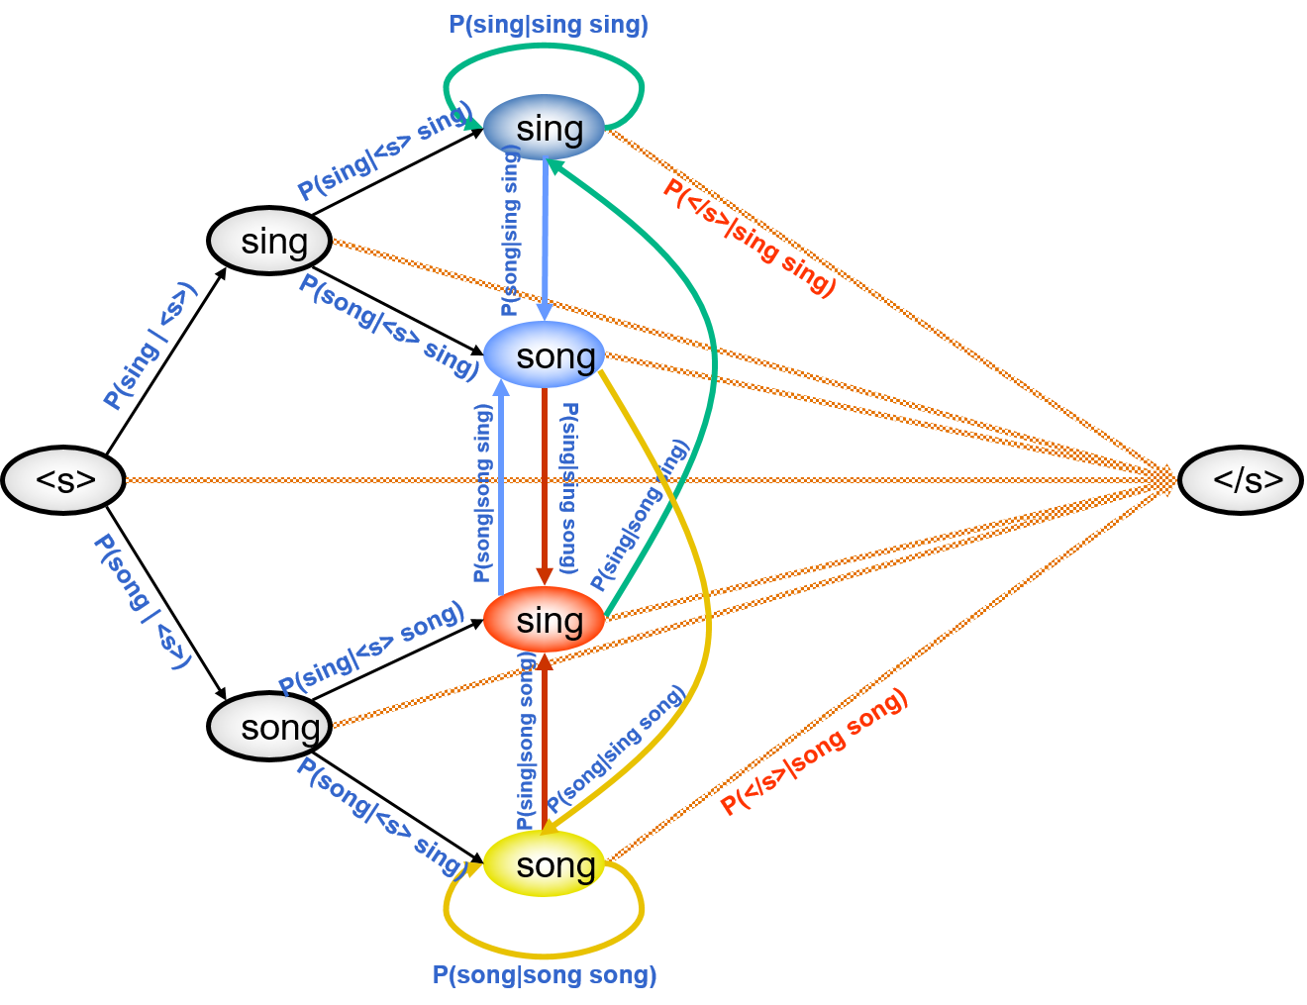
Generating Text
Start at <s>
Randomly choose one of the outgoing edges according to their probability
Stop producing text when you hit </s>

Slide 194
Example
Unigram model estimated on 2.8M words of American political blog text.
this trying our putting and funny
and among it herring it obama
but certainly foreign my
c on byron again but from i
i so and i chuck yeah the as but but republicans if this stay oh so or it mccain bush npr this with what and they right i while because obama

Slide 195
Example
Bigram model estimated on 2.8M words of American political blog text.
the lack of the senator mccain hadn t keep this story backwards
while showering praise of the kind of gop weakness
it was mistaken for american economist anywhere in the white house press hounded the absence of those he s as a wide variety of this election day after the candidate b richardson was polled ri in hempstead moderated by the convention that he had zero wall street journal argues sounds like you may be the primary
but even close the bill told c e to take the obama on the public schools and romney
fred flinstone s see how a lick skillet road it s little sexist remarks

Slide 196
Example
Trigram model estimated on 2.8M words of American political blog text.
as i can pin them all none of them want to bet that any of the might be
conservatism unleashed into the privacy rule book and when told about what paul
fans organized another massive fundraising initiative yesterday and i don t know what the rams supposedly want ooh
but she did but still victory dinner
alone among republicans there are probably best not all of the fundamentalist community
asked for an independent maverick now for crystallizing in one especially embarrassing

Slide 197
Example
5-gram model estimated on 2.8M words of American political blog text.
he realizes fully how shallow and insincere conservative behavior has been he realizes that there is little way to change the situation
this recent arianna huffington item about mccain issuing heartfelt denials of things that were actually true or for that matter about the shia sunni split and which side iran was on would get confused about this any more than someone with any knowledge of us politics would get confused about whether neo confederates were likely to be supporting the socialist workers party
at the end of the world and i m not especially discouraged now that newsweek shows obama leading by three now

Slide 198
Example
100-gram model estimated on 2.8M words of American political blog text.
and it would be the work of many hands to catalogue all the ridiculous pronouncements made by this man since his long train of predictions about the middle east has been gaudily disastrously stupefyingly misinformed just the buffoon it seems for the new york times to award with a guest column for if you object to the nyt rewarding failure in quite this way then you re intolerant according to the times editorial page editor andrew rosenthal rosenthal doesn t seem to recognize that his choice of adjectives to describe kristol serious respected are in fact precisely what is at issue for those whom he dismisses as having a fear of opposing views

Slide 199
N-Gram Models
Pros
Easily understood linguistic formalism.
Fully generative.
Algorithms:
calculate probability of a sequence
choose a sequence from a set
training
Cons
Obviously inaccurate linguistic formalism.
As N grows, data sparseness becomes a problem.
Smoothing is a black art.
How to deal with unknown words?

Slide 200
N-Gram Models
Pros
Easily understood linguistic formalism.
Fully generative.
Algorithms:
calculate probability of a sequence
choose a sequence from a set
training
Cons
Obviously inaccurate linguistic formalism.
As N grows, data sparseness becomes a problem.
Smoothing is a black art.
How to deal with unknown words?

Slide 201
Calculating the Probability of a Sequence
Let n be the length of the sequence and m be the length of the history.
For every consecutive (m+1) words w_{i} … w_{i+m}, look up p(w_{i+m} | w_{i} … w_{i+m-1}).
Look up p(stop | w_{n-m} … w_{n}).
Multiply these quantities together.

Slide 202
Choosing a Sequence from a Set
Calculate the probability of each sequence in the set.
Choose the one that has the highest probability.

Slide 203
Training
Maximum likelihood estimation by relative frequencies:
unigram
bigram
trigram
general

Slide 204
Note about Current Research
In the past few years, “web-scale” n-gram models have become popular.
More data always seem to make language models better (Brants et al., 2007, inter alia)
A number of recent research efforts seek to make the construction and use of language models very efficient.
Runtime: MapReduce architectures (e.g., Lin & Dyer, 2010)
Memory: compression (e.g., Heafield, 2011)
Neural language models
Too many to cite
Not really a “fixed” sized history (n) anymore

Slide 205
Sequence Models as Components
Typically we care about a sequence together with something else.
Analysis: sequence in, predict “something else.”
Generation: “something else in,” sequence out.
Sequence models are useful components in both scenarios.

Slide 206
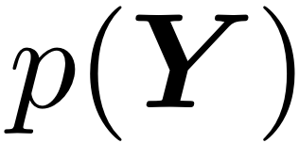
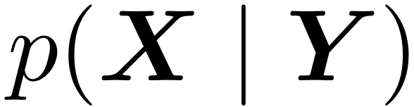

Noisy Channel
source
channel
true Y
X
decoding rule:

Slide 207
Sequence Model as Source
speech recognition (Jelinek, 1997)
machine translation (Brown et al., 1993)
optical character recognition (Kolak and Resnik, 2002)
spelling and punctuation correction (Kernighan et al., 1990)
source
channel
true Y
X
Desired output sequence
Observed sequence
decoding rule:

Slide 208
Sequence Model as Channel
text categorization
language identification
information retrieval (Ponte and Croft, 1998; Berger and Lafferty, 1999)
Sentence compression (Knight and Marcu, 2002)
Question to search query (Radev et al., 2001)
source
channel
true Y
X
Desired output
Observed sequence
decoding rule:

Slide 209
It’s Hard to Beat N-Grams!
They are very fast to work with. They fit the data really, really well.
Improvements for some specific problems follow from:
task-specific knowledge
domain knowledge (e.g., linguistics)

Slide 210
Class-Based Sequence Models
From Brown et al. (1990):
“cl” is a deterministic function from words to a smaller set of classes.
Each word only gets one class; known in advance.
Discovered from data using a clustering algorithm.

Slide 211
start

Slide 212
start
C53
one “next class” die per class:
…
…
…
history = start

Slide 213

Each word appears on only one of the word dice.
start
C53
I
one word die per class:
…
…
…
class = C53

Slide 214
start
C53
C23
I
one “next class” die per class:
…
…
…
history = C53

Slide 215
start
C53
C23
I
want
one word die per class:
…
…
…
class = C23

Slide 216
start
C53
C23
C2
I
want
one “next class” die per class:
…
…
…
history = C23

Slide 217
start
C53
C23
C2
I
want
a
one word die per class:
…
…
…
class = C2

Slide 218
start
C53
C23
C2
C5
I
want
a
one “next class” die per class:
…
…
…
history = C2

Slide 219
start
C53
C23
C2
C5
I
want
a
flight
one word die per class:
…
…
…
class = C5

Slide 220
Class-Based Sequence Models
From Brown et al. (1990):
Independence assumptions?
Number of parameters?
Generalization ability?

Slide 221
Markov Model
P(W|C₁)
C₁
P(W|C₂)
<s>
C₂
</s>
C3
P(W|C₃)
Each time a class is visited, draw a word from the class

Slide 222
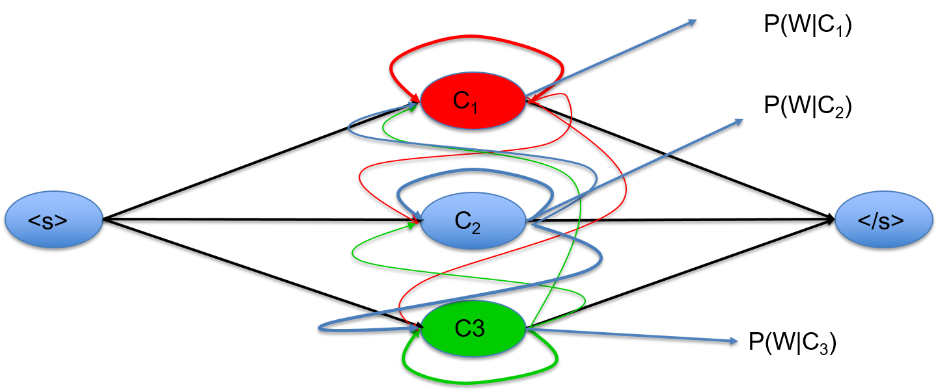
Generating Text
<s>
</s>
<s>
w₁
w₂
w₃
w₄
w₅
</s>
Note the distinction between wandering through the states and producing the text

Slide 223
Lecture Outline
Markov models
Hidden Markov models
Viterbi algorithm

Slide 224
Hidden Markov Models

Slide 225
Hidden Markov Model
A model over sequences of symbols, but there is missing information associated with each symbol: its “state.”
Assume a finite set of possible states, Λ.
A joint model over the observable symbols and their hidden/latent/unknown classes.

Slide 226
start
C53
one “next class” die per class:
…
…
…
history = start

Slide 227
The only change to the class-based model is that now, the different word dice can share words!
start
C53
I
one word die per class:
…
…
…
class = C53

Slide 228
start
C53
C23
I
one “next class” die per class:
…
…
…
history = C53

Slide 229
start
C53
C23
I
want
one word die per class:
…
…
…
class = C23

Slide 230
start
C53
C23
C2
I
want
one “next class” die per class:
…
…
…
history = C23

Slide 231
start
C53
C23
C2
I
want
a
one word die per class:
…
…
…
class = C2

Slide 232
start
C53
C23
C2
C5
I
want
a
one “next class” die per class:
…
…
…
history = C2

Slide 233
start
C53
C23
C2
C5
I
want
a
flight
one word die per class:
…
…
…
class = C5

Slide 234
Two Equivalent Stories
First, as shown: transition, emit, transition, emit, transition, emit.
Second:
Generate the sequence of transitions. Essentially, a Markov model on classes.
Stochastically replace each class with a word.

Slide 235
m^{th} Order Hidden Markov Models
We can condition on a longer history of past states:
Number of parameters?
Benefit: longer “memory.”
Today I will stick with first-order HMMs.

Slide 236
Uses of HMMs in NLP
Part-of-speech tagging (Church, 1988; Brants, 2000)
Named entity recognition (Bikel et al., 1999) and other information extraction tasks
Text chunking and shallow parsing (Ramshaw and Marcus, 1995)
Word alignment in parallel text (Vogel et al., 1996)
Also popular in computational biology and central to speech recognition.

Slide 237
Part of Speech Tagging
After paying the medical bills , Frances was nearly broke .
rb vbg dt jj nns , nnp vbz rb jj .
Adverb (RB)
Verb (VBG, VBZ, and others)
Determiner (DT)
Adjective (JJ)
Noun (NN, NNS, NNP, and others)
Punctuation (., ,, and others)

Slide 238
Named Entity Recognition
With Commander Chris Ferguson at the helm , Atlantis touched down at Kennedy Space Center .

Slide 239
Named Entity Recognition
With Commander Chris Ferguson at the helm , Atlantis touched down at Kennedy Space Center .
What makes this hard?
O
B-person
I-person
I-person
O
O
O
O
B-space-shuttle
O
O
O
B-place
I-place
I-place
O

Slide 240
Word Alignment
Mr. President , Noah’s ark was filled not with production factors , but with living creatures.
null Noahs Arche war nicht voller Productionsfactoren , sondern Geschöpfe .

Slide 241
Word Alignment
Mr. President , Noah’s ark was filled not with production factors , but with living creatures.
null Noahs Arche war nicht voller Productionsfactoren , sondern Geschöpfe .

Slide 242
Word Alignment
Mr. President , Noah’s ark was filled not with production factors , but with living creatures.
null Noahs Arche war nicht voller Productionsfactoren , sondern Geschöpfe .

Slide 243
Word Alignment
Mr. President , Noah’s ark was filled not with production factors , but with living creatures.
null Noahs Arche war nicht voller Productionsfactoren , sondern Geschöpfe .

Slide 244
Word Alignment
Mr. President , Noah’s ark was filled not with production factors , but with living creatures.
null Noahs Arche war nicht voller Productionsfactoren , sondern Geschöpfe .

Slide 245
Word Alignment
Mr. President , Noah’s ark was filled not with production factors , but with living creatures.
null Noahs Arche war nicht voller Productionsfactoren , sondern Geschöpfe .

Slide 246
Word Alignment
Mr. President , Noah’s ark was filled not with production factors , but with living creatures.
null Noahs Arche war nicht voller Productionsfactoren , sondern Geschöpfe .

Slide 247
Word Alignment
Mr. President , Noah’s ark was filled not with production factors , but with living creatures.
null Noahs Arche war nicht voller Productionsfactoren , sondern Geschöpfe .

Slide 248
Word Alignment
Mr. President , Noah’s ark was filled not with production factors , but with living creatures.
null Noahs Arche war nicht voller Productionsfactoren , sondern Geschöpfe .

Slide 249
Word Alignment
Mr. President , Noah’s ark was filled not with production factors , but with living creatures.
null Noahs Arche war nicht voller Productionsfactoren , sondern Geschöpfe .

Slide 250
Hidden Markov Model
A model over sequences of symbols, but there is missing information associated with each symbol: its “state.”
Assume a finite set of possible states, Λ.
A joint model over the observable symbols and their hidden/latent/unknown classes.

Slide 251
Lecture Outline
Markov models
Hidden Markov models
Viterbi algorithm

Slide 252
Viterbi Algorithm

Slide 253
Algorithms for HMMs
Given the HMM and a sequence:
The most probable state sequence?
The probability of the word sequence?
The probability distribution over states, for each word?
Minimum risk sequence
Given states and sequences, or just states:
The parameters of the HMM (γ and η)?

Slide 254
Problem 1: Most Likely State Sequence
Input: HMM (γ and η) and symbol sequence w.
Output:
Statistics view: maximum a posteriori inference
Computational view: discrete, combinatorial optimization

Slide 255
Example
 | I | suspect | the | present | forecast | is | pessimistic | .
 | cd | jj | dt | jj | nn | nns | jj | .
 | nn | nn | jj | nn | vb | vbz
 | nnp | vb | nn | rb | vbd
 | prp | vbp | nnp | vb | vbn
 |  |  | vbp | vbp | vbp
 | 4 | 4 | 5 | 5 | 5 | 2 | 1 | 1
4,000 possible state sequences!

Slide 256
Naïve Solutions
List all the possibilities in Λ^{n}.
Correct.
Inefficient.
Work left to right and greedily pick the best s_{i} at each point, based on s_{i-1} and w_{i}.
Not correct; solution may not be equal to:
But fast!

Slide 257
Interactions
Each word’s label depends on the word, and nearby labels.
But given adjacent labels, others do not matter.
 | I | suspect | the | present | forecast | is | pessimistic | .
 | cd | jj | dt | jj | nn | nns | jj | .
 | nn | nn | jj | nn | vb | vbz
 | nnp | vb | nn | rb | vbd
 | prp | vbp | nnp | vb | vbn
 |  |  | vbp | vbp | vbp
(arrows show most preferred label by each neighbor)

Slide 258
Base Case: Last Label
 |  | start | w₁ | w₂ | w₃ | … | w_{n-1} | w_{n} | stop
σ₁
σ₂
σ₃ |  |  |  |  |  |  | ✓
σ₄
︙
σ_{|Λ|}
Of course, we do not actually know s_{n-1}!

Slide 259
Recurrence
If I knew the score of every sequence s₁ … s_{n-1}, I could reason easily about s_{n}.
But my decision about s_{n} would only depend on s_{n-1}!
So I really only need to know the score of the best sequence ending in each s_{n-1}.
Think of that as some “precalculation” that happens before I think about s_{n}.

Slide 260
Recurrence
Assume we have the scores for all prefixes of the current state sequence.
One score for each possible last-state of the prefix.

Slide 261
Recurrence
The recurrence “bottoms out” at start.
This leads to a simple algorithm for calculating all the scores.

Slide 262
Viterbi Algorithm (Scores Only)
For every σ in Λ, let:
For i = 2 to n – 1, for every σ in Λ:
For every σ in Λ:
Claim:

Slide 263
Exploiting Distributivity

Slide 264
 | I | suspect | the | present | forecast | is | pessimistic | .
cd | 3e-7
dt |  |  | 3e-8
jj |  | 1e-9 | 1e-12 | 3e-12 |  |  | 7e-23
nn | 4e-6 | 2e-10 | 1e-13 | 6e-13 | 4e-16
nnp | 1e-5 |  | 4e-13
nns |  |  |  |  |  | 1e-21
prp | 4e-3
rb |  |  |  | 2e-14
vb |  | 6e-9 |  | 3e-15 | 2e-19
vbd |  |  |  |  | 6e-18
vbn |  |  |  |  | 4e-18
vbp |  | 5e-7 | 4e-14 | 4e-15 | 9e-19
vbz |  |  |  |  |  | 6e-18
. |  |  |  |  |  |  |  | 2e-24
 | 1 | 2 | 3 | 4 | 5 | 6 | 7 | 8

Slide 265
Not Quite There
As described, this algorithm only lets us calculate the probability of the best label sequence.
It does not recover the best sequence!

Slide 266
Understanding the Scores
score_{i}(σ) is the score of the best sequence labeling up through w_{i}, ignoring what comes later.
Similar trick as before: if I know what s_{i+1} is, then I can use the scores to choose s_{i}.
Solution: keep backpointers.

Slide 267
 | I | suspect | the | present | forecast | is | pessimistic | .
cd | 3e-7
dt |  |  | 3e-8
jj |  | 1e-9 | 1e-12 | 3e-12 |  |  | 7e-23
nn | 4e-6 | 2e-10 | 1e-13 | 6e-13 | 4e-16
nnp | 1e-5 |  | 4e-13
nns |  |  |  |  |  | 1e-21
prp | 4e-3
rb |  |  |  | 2e-14
vb |  | 6e-9 |  | 3e-15 | 2e-19
vbd |  |  |  |  | 6e-18
vbn |  |  |  |  | 4e-18
vbp |  | 5e-7 | 4e-14 | 4e-15 | 9e-19
vbz |  |  |  |  |  | 6e-18
. |  |  |  |  |  |  |  | 2e-24

Slide 268
 | I | suspect | the | present | forecast | is | pessimistic | .
cd | 3e-7
dt |  |  | 3e-8
jj |  | 1e-9 | 1e-12 | 3e-12 |  |  | 7e-23
nn | 4e-6 | 2e-10 | 1e-13 | 6e-13 | 4e-16
nnp | 1e-5 |  | 4e-13
nns |  |  |  |  |  | 1e-21
prp | 4e-3
rb |  |  |  | 2e-14
vb |  | 6e-9 |  | 3e-15 | 2e-19
vbd |  |  |  |  | 6e-18
vbn |  |  |  |  | 4e-18
vbp |  | 5e-7 | 4e-14 | 4e-15 | 9e-19
vbz |  |  |  |  |  | 6e-18
. |  |  |  |  |  |  |  | 2e-24

Slide 269
Viterbi Algorithm
For every σ in Λ, let:
For i = 2 to n – 1, for every σ in Λ:
For every σ in Λ:

Slide 270
Viterbi Algorithm: Backtrace
After calculating all score and bp values, start by choosing s_{n} to maximize score_{n}.
Then let s_{n-1} = bp_{n}(s_{n}).
In general, s_{i-1} = bp_{i}(s_{i}).

Slide 271
Another Example
 | time | flies | like | an | arrow | .
dt |  |  |  | 10e-15 | 6e-21
in |  |  | 8e-13 |  | 1e-19
jj |  |  | 6e-14 |  | 2e-16
nn | 2e-4 |  |  |  | 3e-16
nnp |  |  |  |  | 1e-16
vb | 2e-7 |  | 1e-14 |  | 1e-19
vbp |  |  | 8e-16 |  | 4e-19
vbz |  | 2e-9 |  |  | 3e-18
. |  |  |  |  | 1e-21 | 3e-17
, |  |  |  | 4e-20 | 5e-22

Slide 272
Another Example
 | time | flies | like | an | arrow | .
dt |  |  |  | 10e-15 | 6e-21
in |  |  | 8e-13 |  | 1e-19
jj |  |  | 6e-14 |  | 2e-16
nn | 2e-4 |  |  |  | 3e-16
nnp |  |  |  |  | 1e-16
vb | 2e-7 |  | 1e-14 |  | 1e-19
vbp |  |  | 8e-16 |  | 4e-19
vbz |  | 2e-9 |  |  | 3e-18
. |  |  |  |  | 1e-21 | 3e-17
, |  |  |  | 4e-20 | 5e-22

Slide 273
General Idea: Dynamic Programming
Use a table data structure to store partial quantities that will be reused many times.
Optimal substructure: best solution to a problem relies on best solutions to its (similar-looking) subproblems.
Overlapping subproblems: reuse a small number of quantities many times
Examples: Viterbi, minimum Levenshtein distance, Dijkstra’s shortest path algorithm, …

Slide 274
A Different View: Best Path

Slide 275
Asymptotic Analysis
Memory:
The table is n ⨉ |Λ|.
Runtime:
Each cell in the table requires O(|Λ|) operations.
Total runtime is O(n|Λ|²).

Slide 276
Lecture Outline
Markov models
Hidden Markov models
Viterbi algorithm

